Slide 1
CO 2
Session no. 15

Slide 2
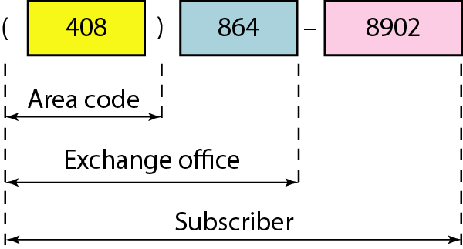
hierarchy in an IPv4 address

Slide 3
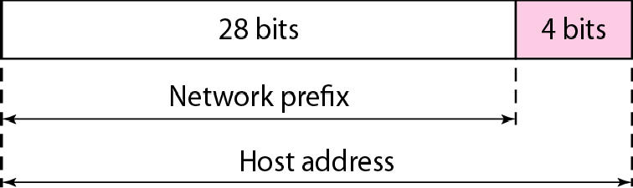
Two levels of hierarchy in an IPv4 address

Slide 4
Each address in the block can be considered as a two-level hierarchical structure:
the leftmost n bits (prefix) define the network;
the rightmost 32 − n bits define the host.

Slide 5
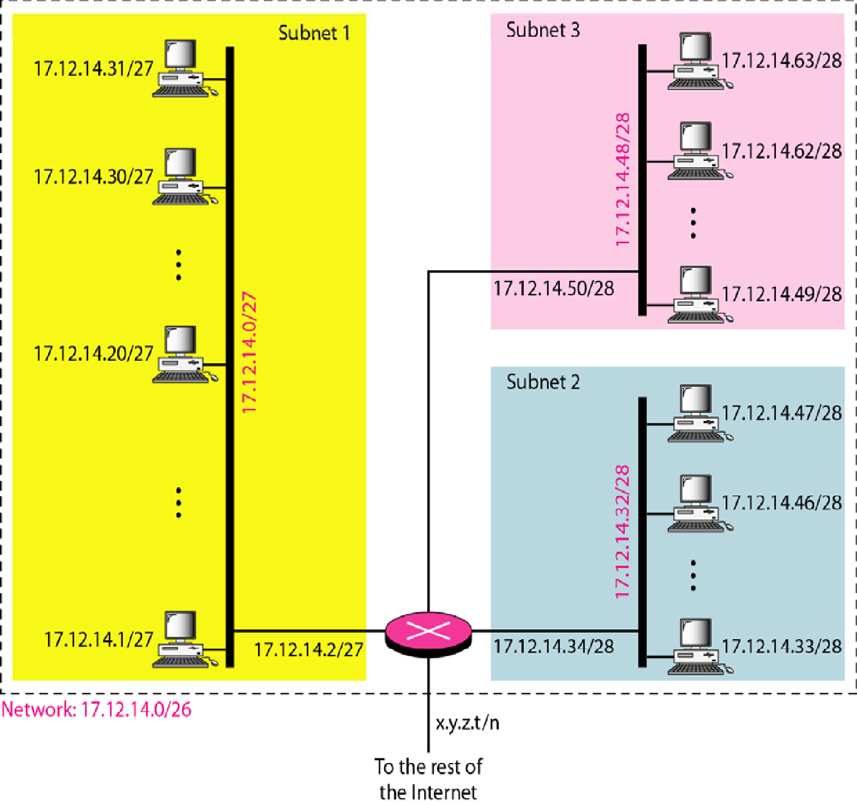
Configuration and addresses in a subnetted network

Slide 6
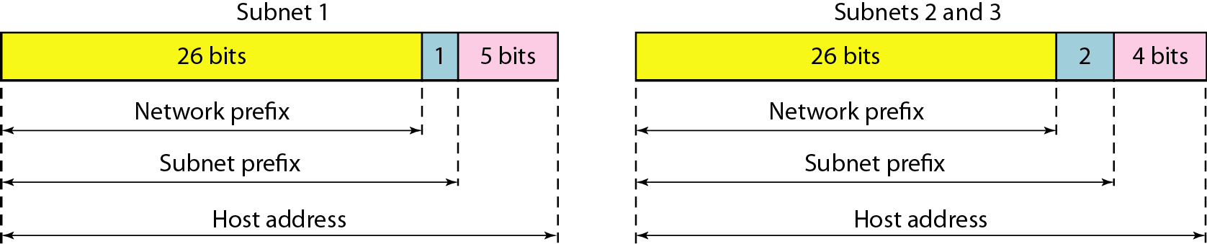
Three-level hierarchy in an IPv4 address

Slide 7
Example
An ISP is granted a block of addresses starting with 190.100.0.0/16 (65,536 addresses). The ISP needs to distribute these addresses to three groups of customers as follows:
The first group has 64 customers; each needs 256 addresses.
The second group has 128 customers; each needs 128 addresses.
The third group has 128 customers; each needs 64 addresses.
Design the subblocks and find out how many addresses are still available after these allocations.

Slide 8


Example (continued)
Group 1
For this group, each customer needs 256 addresses. This means that 8 (log2 256) bits are needed to define each host. The prefix length is then 32 − 8 = 24. The addresses are

Slide 9
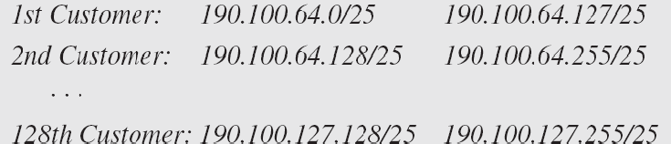
Example (continued)
Group 2
For this group, each customer needs 128 addresses. This means that 7 (log2 128) bits are needed to define each host. The prefix length is then 32 − 7 = 25. The addresses are

Slide 10

Example (continued)
Group 3
For this group, each customer needs 64 addresses. This means that 6 (log₂64) bits are needed to each host. The prefix length is then 32 − 6 = 26. The addresses are
Number of granted addresses to the ISP: 65,536 Number of allocated addresses by the ISP: 40,960 Number of available addresses: 24,576

Slide 11
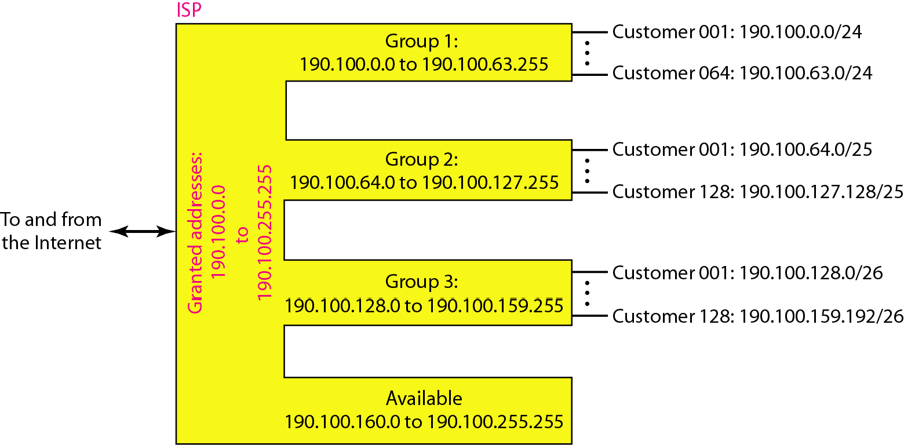
An example of address allocation and distribution by an ISP

Slide 12
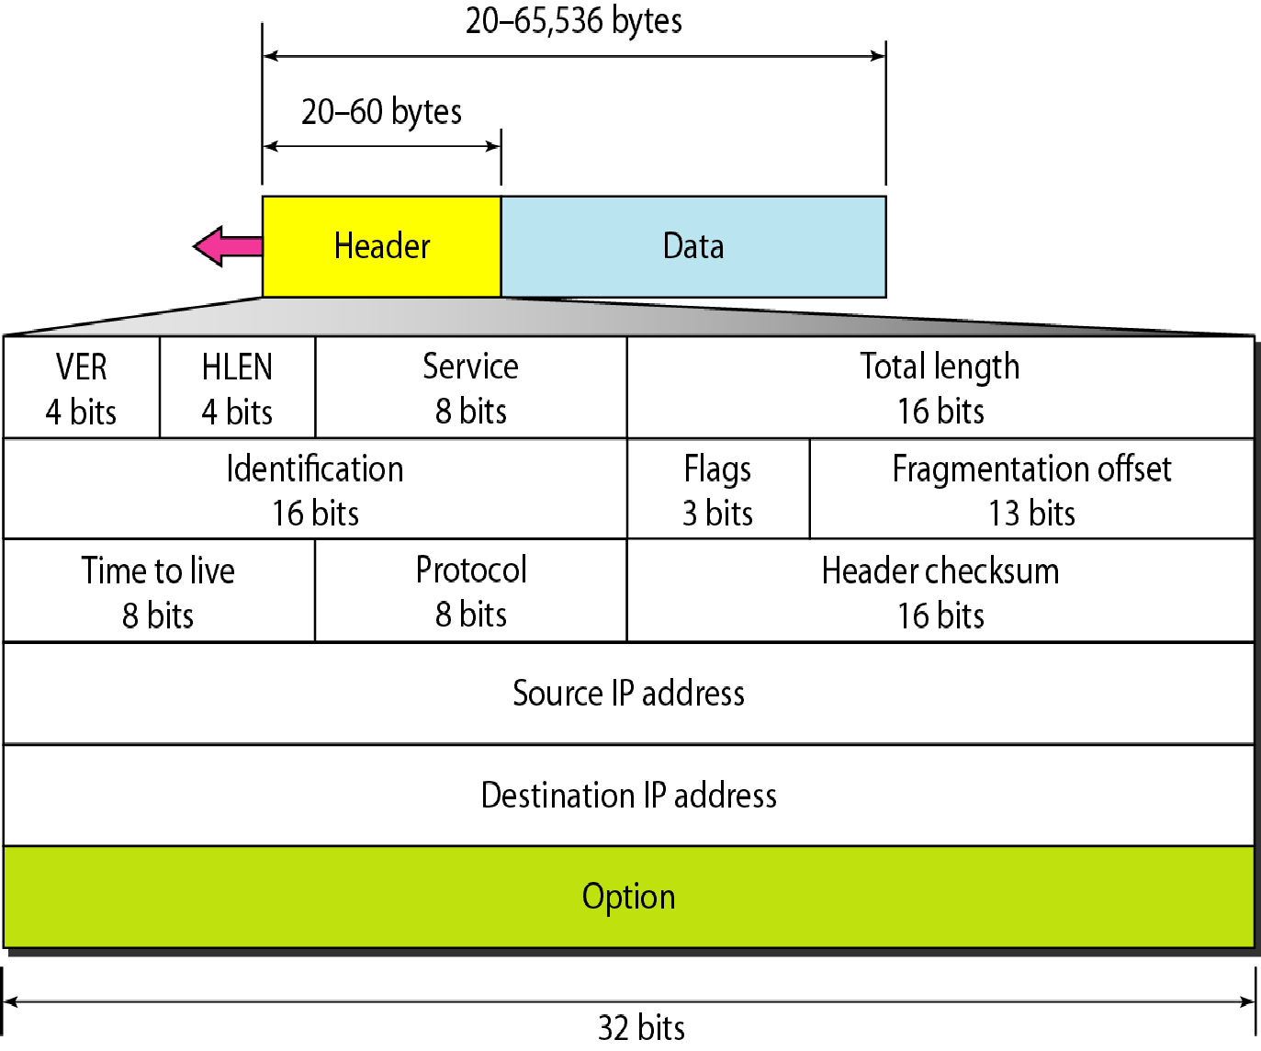
IPv4 datagram format

Slide 13
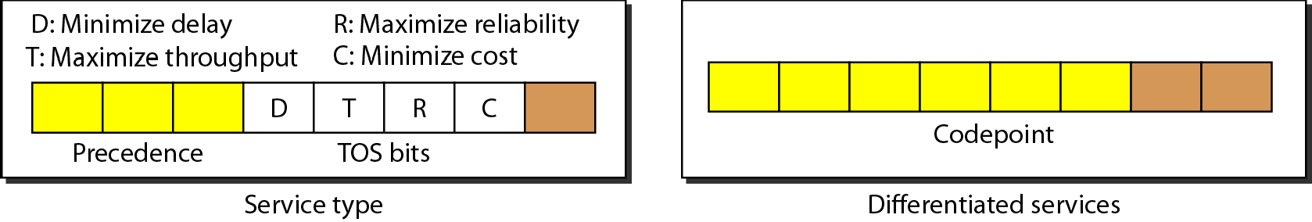
Service type or differentiated services

Slide 14
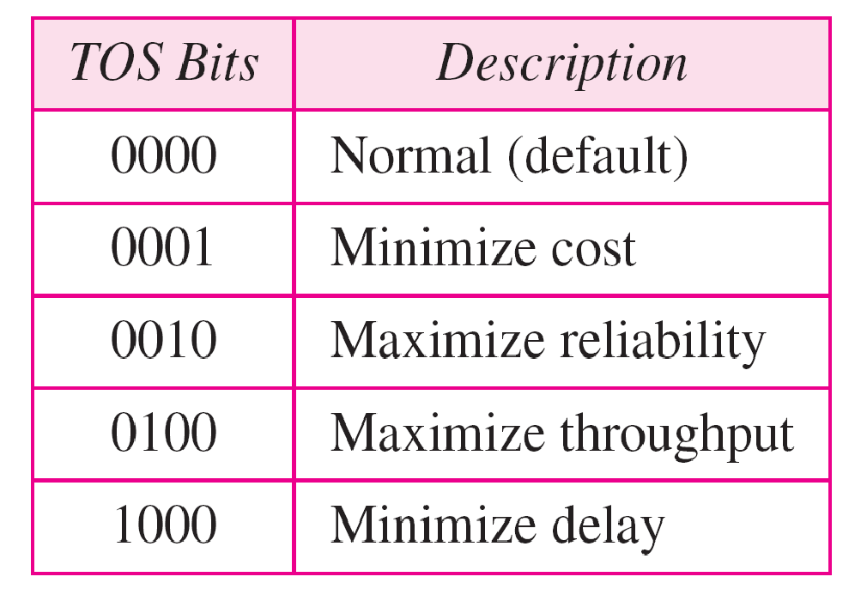
Types of service

Slide 15
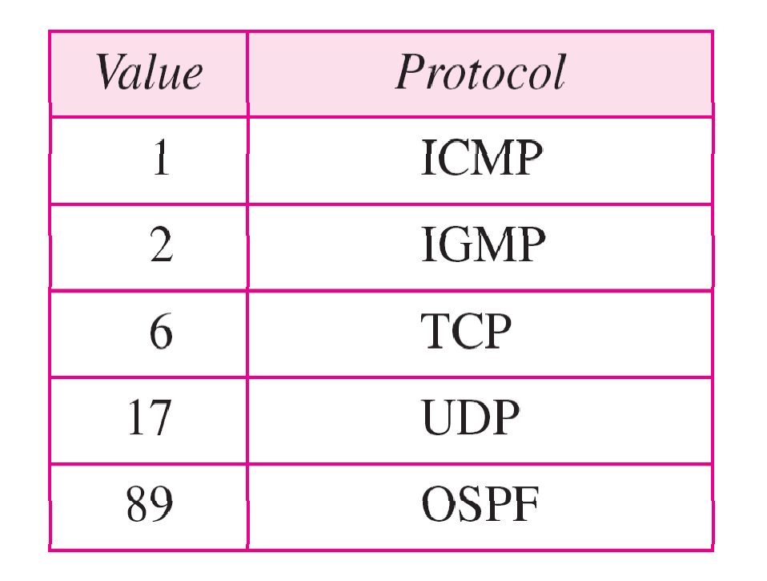
Values for codepoints

Slide 16
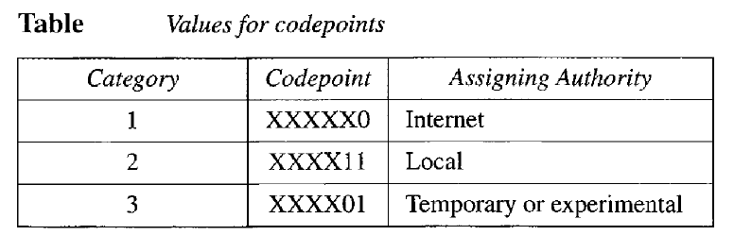

Slide 17
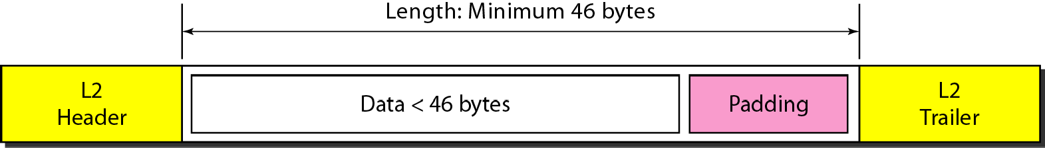
Encapsulation of a small datagram in an Ethernet frame

Slide 18
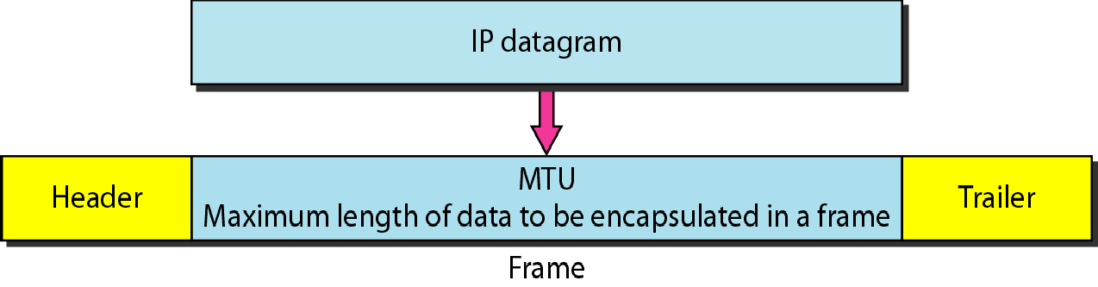
Figure Maximum transfer unit (MTU)

Slide 19
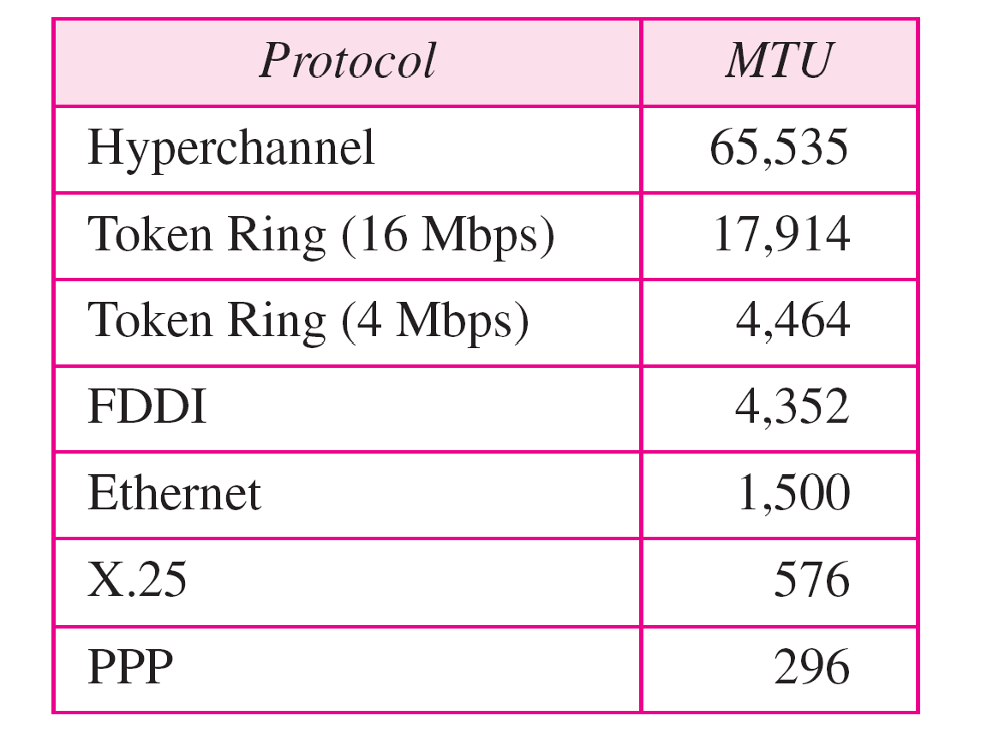
MTUs for some networks

Slide 20

Flags used in fragmentation

Slide 21
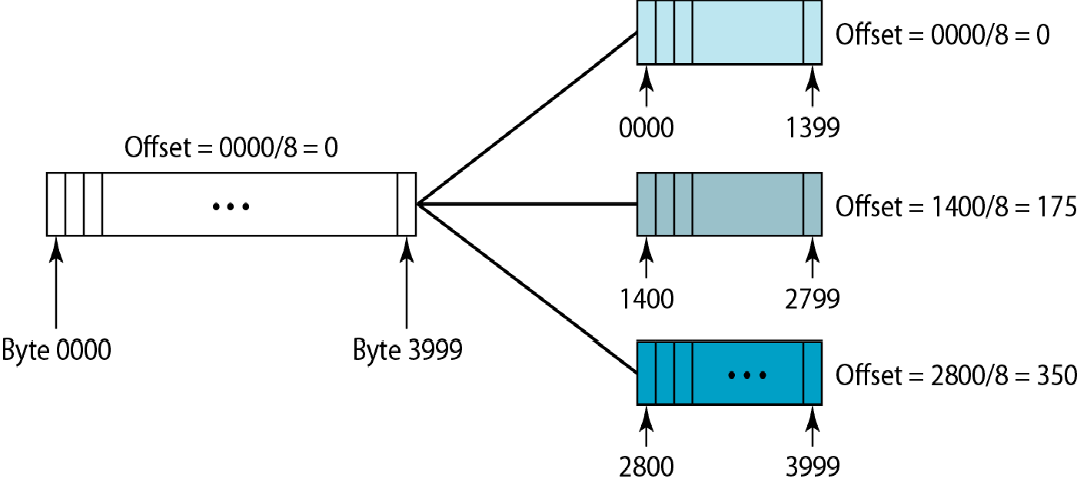
Fragmentation example

Slide 22
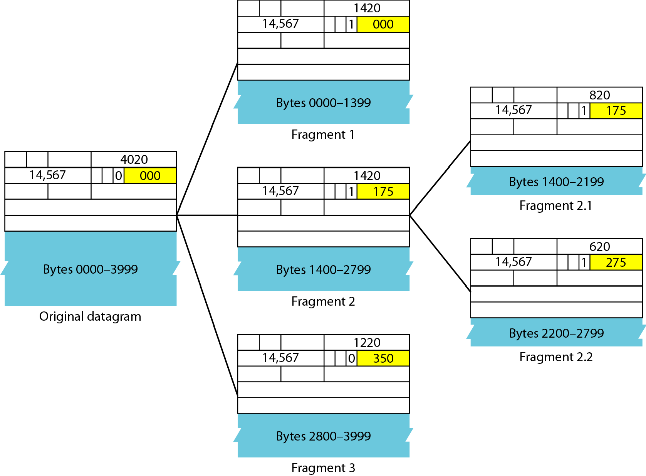
Detailed fragmentation example

Slide 23
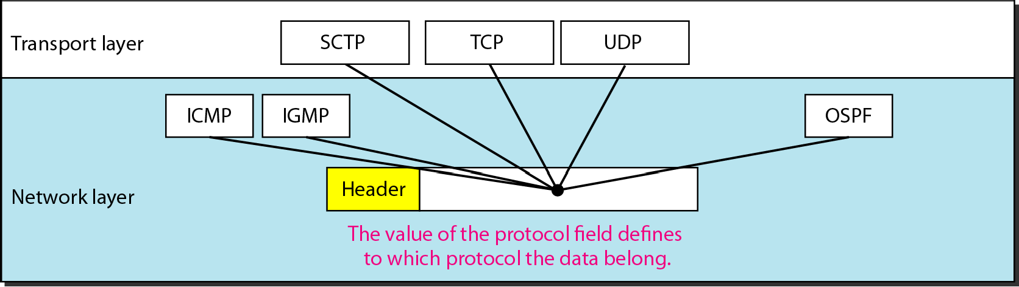
Protocol field and encapsulated data

Slide 24
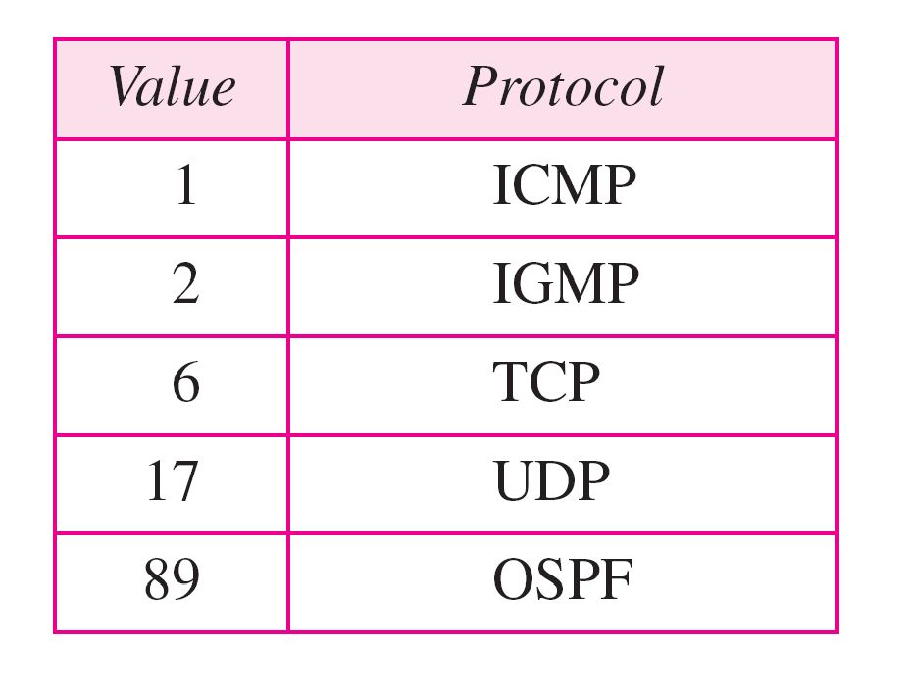
Protocol values

Slide 25
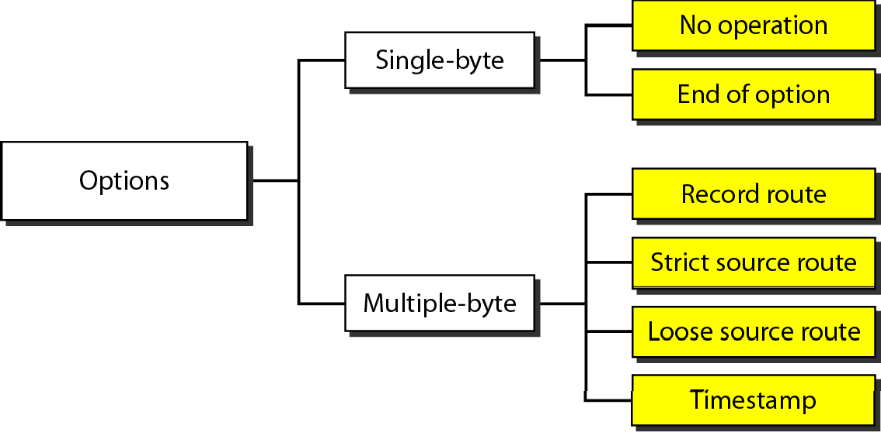
Taxonomy of options in IPv4

Slide 26
IPV6
Despite all short-term solutions, address depletion is still a long-term problem for the Internet. This and other problems in the IP protocol itself have been the motivation for IPv6.
An IPv6 address is 128 bits long

Slide 27
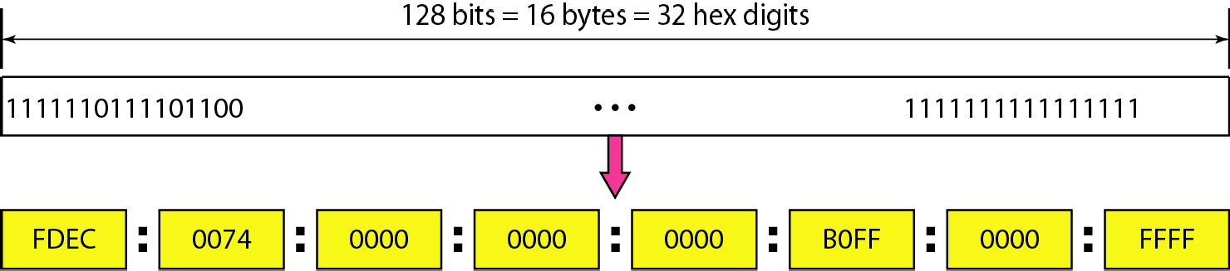
IPv6 address in binary and hexadecimal colon notation

Slide 28
The leading zeros of a section (four digits between two colons) can be omitted. Only the leading zeros can be dropped, not the trailing zeros

Slide 29
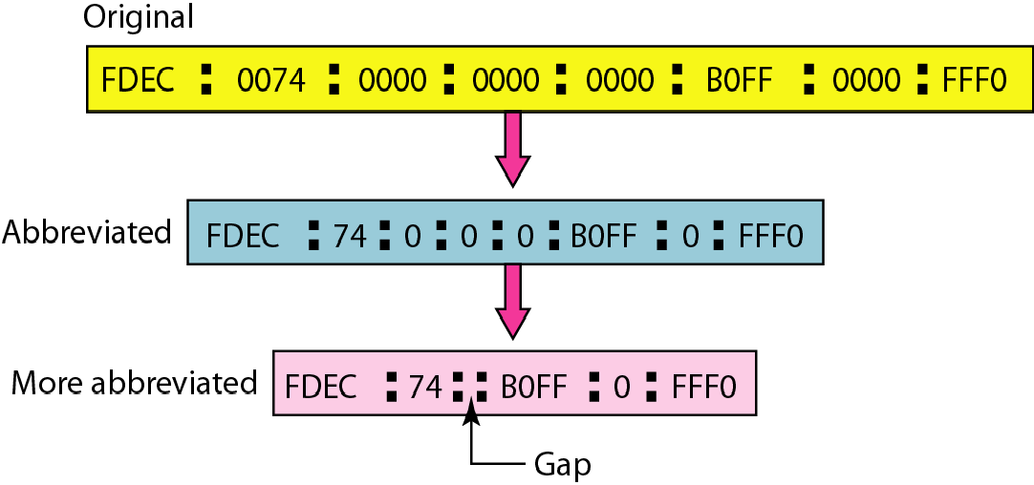
Abbreviated IPv6 addresses

Slide 30
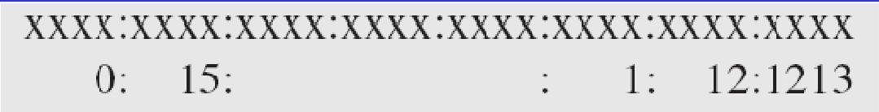
Expand the address 0:15::1:12:1213 to its original.
Solution
We first need to align the left side of the double colon to the left of the original pattern and the right side of the double colon to the right of the original pattern to find how many 0s we need to replace the double colon.
This means that the original address is.

Slide 31
IPv6
The network layer protocol in the TCP/IP protocol suite is currently IPv4. Although IPv4 is well designed, data communication has evolved since the inception of IPv4 in the 1970s. IPv4 has some deficiencies that make it unsuitable for the fast-growing Internet..
Topics discussed in this section:
Advantages Packet Format Extension Headers

Slide 32
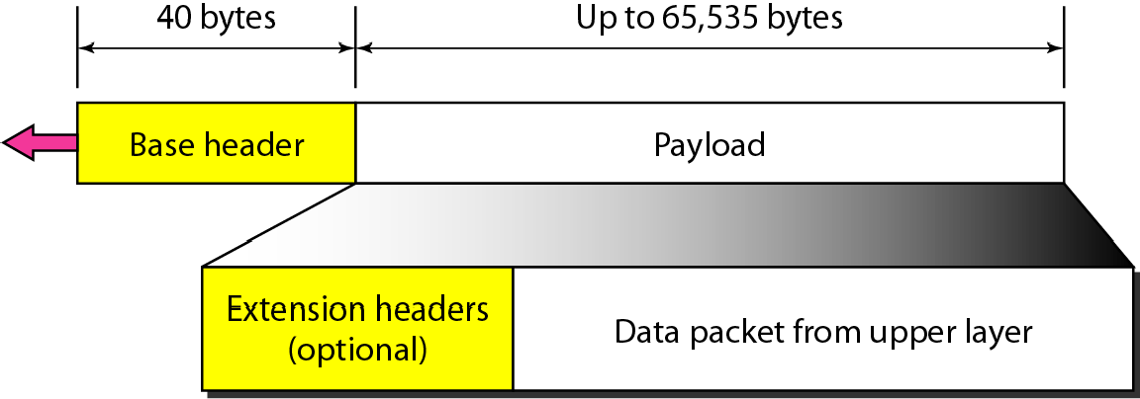
IPv6 datagram header and payload

Slide 33
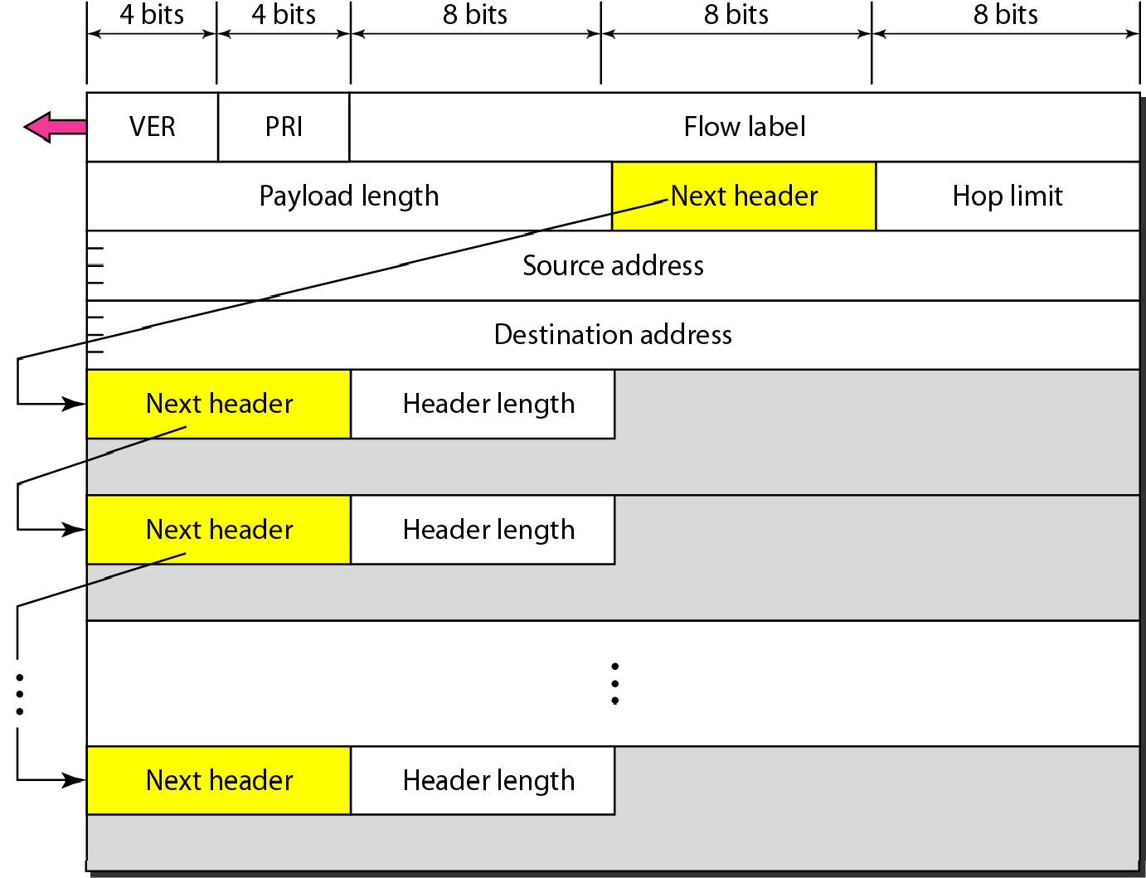
Format of an IPv6 datagram

Slide 34
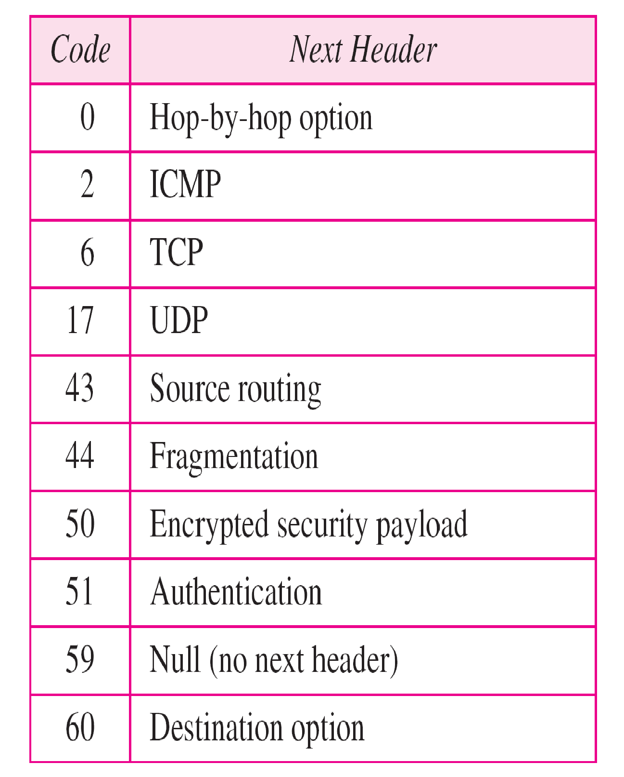
Next header codes for IPv6

Slide 35
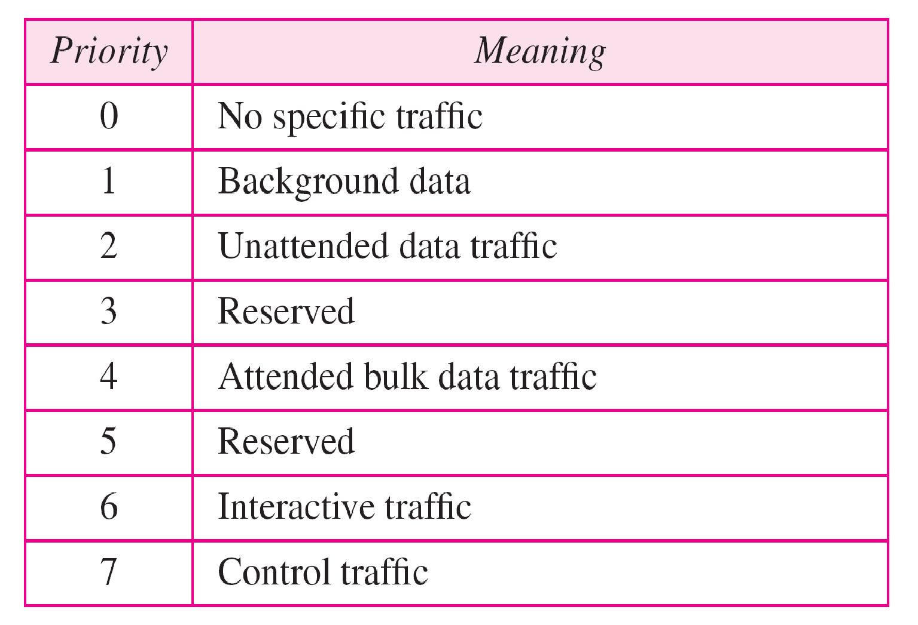
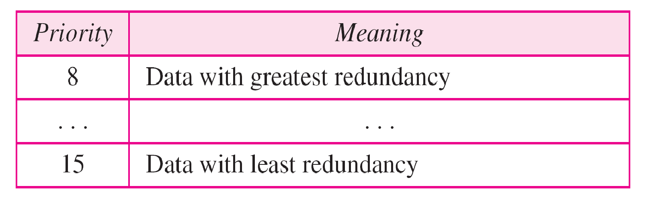
Priorities for congestion-controlled traffic

Slide 36
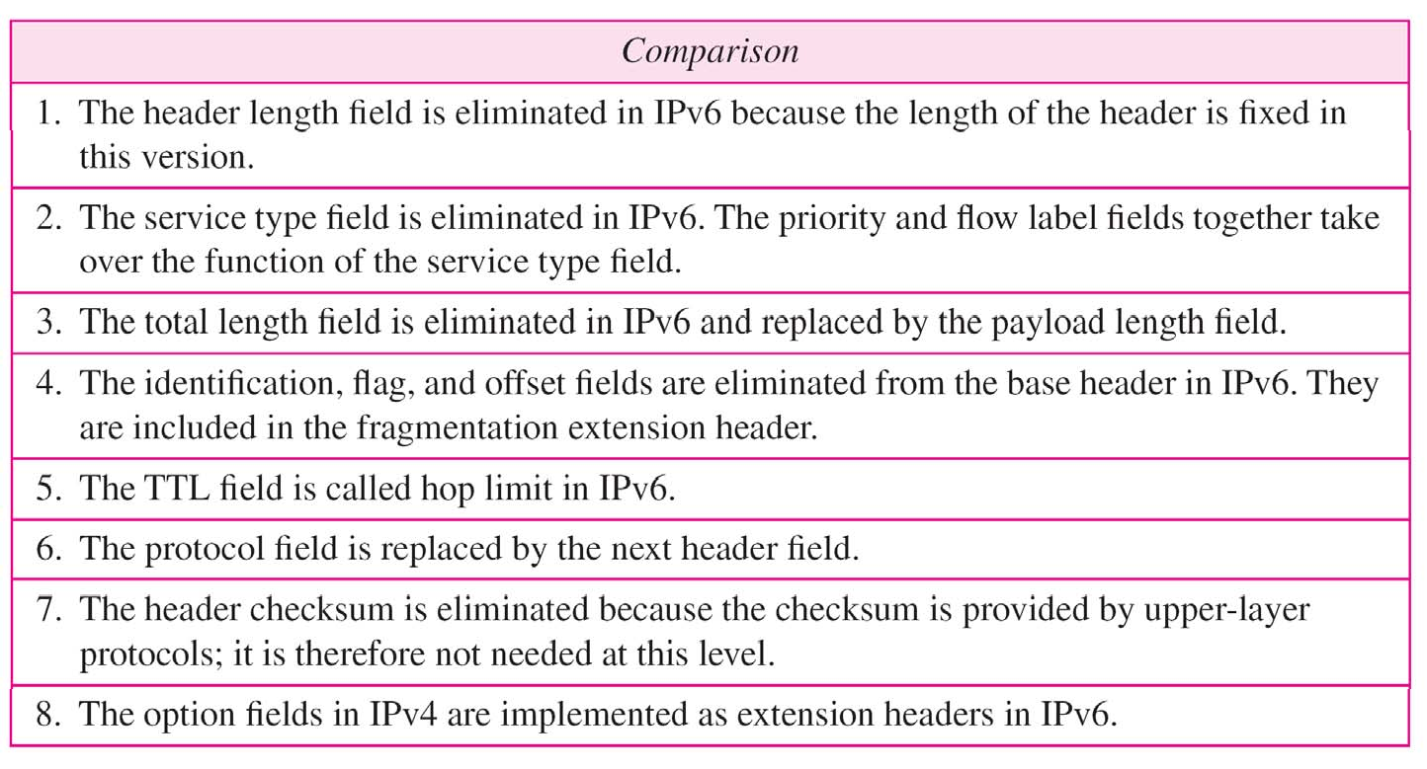
Comparison between IPv4 and IPv6 packet headers

Slide 37
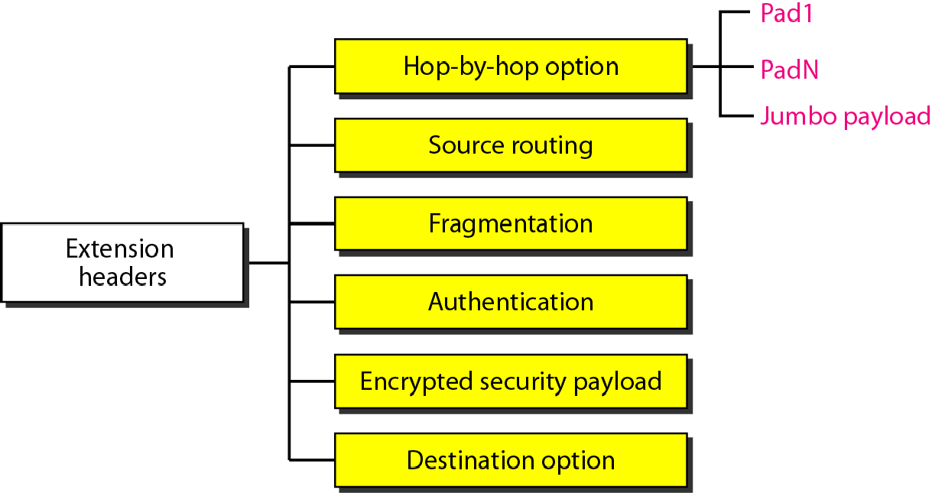
Extension header types

Slide 38
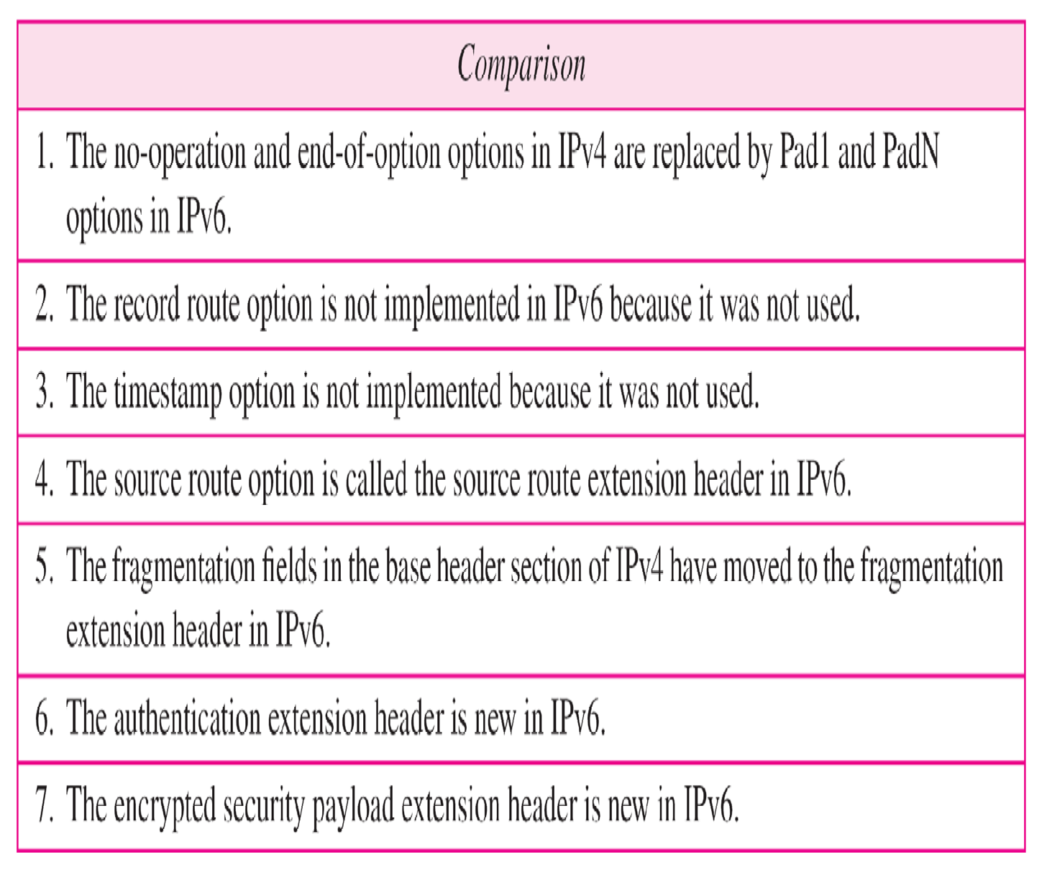
Comparison between IPv4 options and IPv6 extension headers

